Slide 1
CSF 2113 Programming for Information Security
Containers (CLO 1)
Muhammad Humayoun, PhD
Assistant Professor
mhumayoun@hct.ac.ae
Abu Dhabi Men’s College

Slide 2
Containers
Lists A collection of values.
String data type
Tuples A collection of values as a record.
Dictionaries A table of name, value pairs.

Slide 3
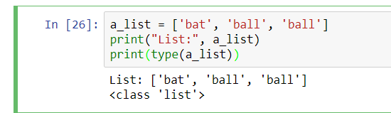
Lists
Elements
A list is a sequence of values (objects).
Individual values in a list are called elements.
Lists have a type and are considered values themselves.
To write a literal list in your program, use the square brackets:
The length of a_list is 3 (the number of elements)
>>> print(len(a_list)) # gives 3 (an integer)

Slide 4
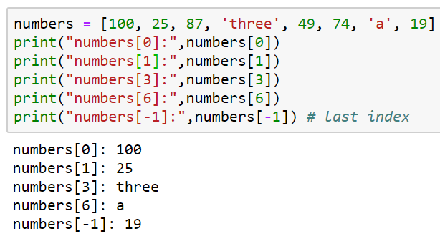
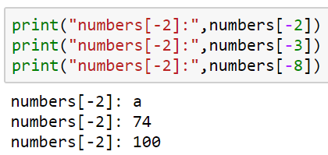
Working with lists
Lists may contain elements of different types (though unusual)
Elements are numbered starting from zero
As with strings, we call this the position or index of the element
Accessing values in a list:
Value | 100 | 25 | 87 | three | 49 | 74 | a | 19
index | 0 | 1 | 2 | 3 | 4 | 5 | 6 | 7
 | -8 | -7 | -6 | -5 | -4 | -3 | -2 | -1

Slide 5
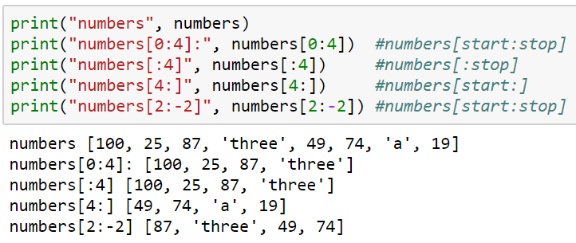
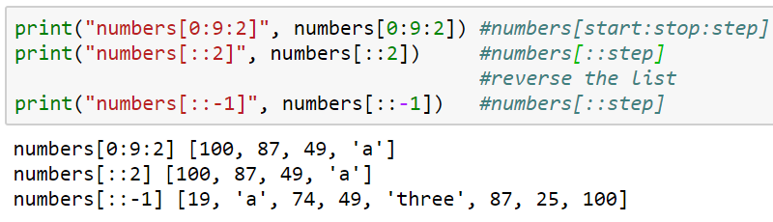
List Slicing
Range: [start:stop:step] all optional
Try numbers[0:100]
List element from index 0 to 100 should be shown.
Since the max index is 7, the whole will be shown without an error

Slide 6
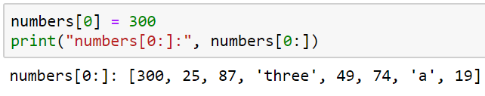
List mutability
Lists are mutable, they can be changed in several ways:
Appending or inserting a new element
Removing an element
Sorting and reversing
Changing the values of existing elements with assignment

Slide 7
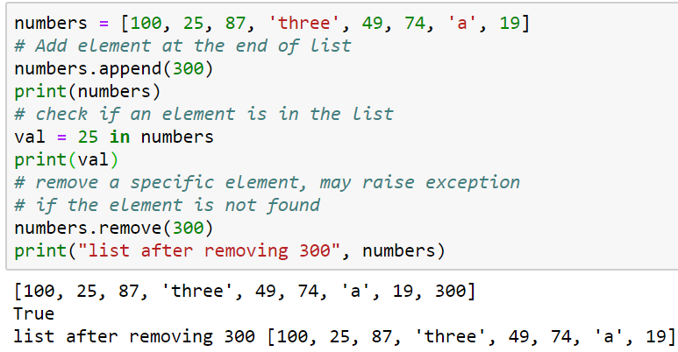
Adding new things to a list
Add elements: The append method adds a new element to the end of a list
The append method:
Mutates the list
Increases the length by one
Does NOT return a value
# gives [100, 25, 87, ‘three’, 49, 74, ‘a’, 19, 300]
Extending a list
To add a whole list to the end, use the extend method
scores = [80, 70, 60]
scores.extend([55, 88, 79])
# gives [80, 70, 60, 55, 88, 79 ]
This increases the length by 3
Returns nothing!

Slide 8
What if you used append instead of extend? (from previous slide)
sc = [80, 70, 60]
sc.append ([55, 88, 79])
Would give [ 80, 70, 60, [55, 88, 79] ]
Adds the list as a single element
The insert method adds a new element at a given location
sc.insert (2, “Rana”)
The new element will be at position 2 (that is, two elements to the left of it)
The other elements move to the right to make room, so no data is lost
[ 80, 70, “Rana”, 60, [55, 88, 79] ]
Remove elements from a list:
This call will remove the first occurrence of 300 from the list numbers
Exception/error if the element not found

Slide 9
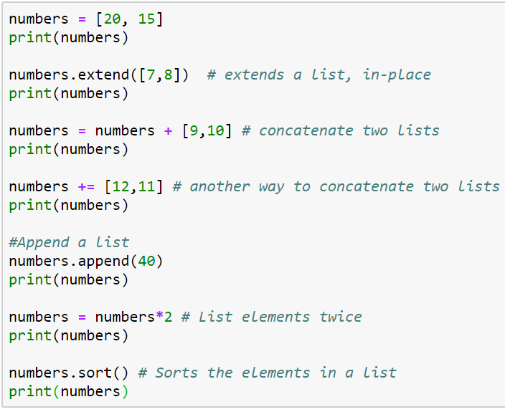
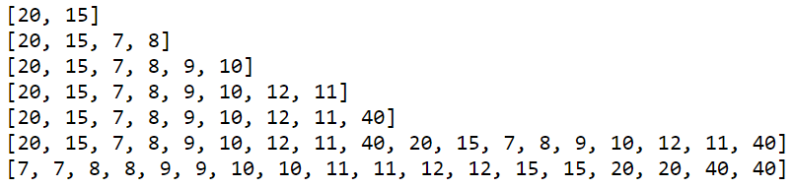
Lets do it together...
Beware: list vs. element

Slide 10
Mutation versus making new objects
Notice that append, extend and insert return nothing!
Most mutating functions in Python work this way
With a few exceptions later
So do NOT do this
numbers = numbers.append(255) # ERROR – it will make numbers = None!
Instead:
numbers.append(255) # GOOD – adds 255 at end
Conversely, concatenating with + does NOT mutate the list
Instead, it returns a new list
So do NOT do this
numbers + scores # ERROR – does not store the new longer list
Instead:
numbers = numbers + scores # or numbers += scores

Slide 11
Searching in lists
There are two ways to search for an element in a list:
You can use the in operator to check whether it’s there:
>>>students = ["Tahir", "Ali", "Anas"]
>>>b = "Tahir" in students
>>>print(b)
The in operator checks for that exact element, does not look “inside” elements
>>>“Hawk” in students # False!
To find an element’s position in the list, use the index method
loc = students.index(“Ali”) # loc is 1
An Exception/error is thrown if this element is not in the list

Slide 12
Reversing a list
The reverse method reverses the order of a list
mylist = [“red”, “green”, “blue”]
mylist.reverse()
print(mylist) #gives [“blue”, “green”, “red”]
reverse mutates the list!
The original order is lost
And reverse does not return a value
So do NOT do this:
mylist = mylist.reverse() # ERROR – mylist becomes None !

Slide 13
Reversing a list
If you need a new reversed copy of the list, use
backwards = list(reversed(mylist))
For this one, mylist is unchanged, backwards is a new list
Note the difference:
reverse is a method that mutates the list that is its argument
reversed is a function that returns a new sequence
It does not actually return a list, but you can convert it with the list typecast

Slide 14
Sorting a list
You can also sort a list using the sort method
Defaults to ascending order
scores = [ 75, 63, 92 ]
scores.sort()
print(scores) # gives [63, 75, 92]
For strings, that means alphabetic (ASCII) order
physicists = [“Taher”, “Shahab”, “Husnain”]
physicists.sort()
print(physicists) # [“Husnain”, “Shahab”, “Taher”]

Slide 15
Sorting a list
Can do descending order instead:
scores.sort(reverse = True)
print(scores) # gives [92, 75, 63]
To make a new sorted list and keep the original list too
ordered_list = sorted(scores)
# does not mutate scores
scores is unchanged
sorted does make a new list
Similar to the difference between reverse and reversed

Slide 16
How to create a list
We’ve seen several different ways we can make a list:
Hard code it: lst = [ 1, 2, 3]
Start out with an empty list and append to it
lst = []
lst.append(1)
lst.append(2)
Useful as an accumulator
Start out with an empty list and concatenate to it
lst = []
lst += [1]
lst += [2]

Slide 17
How to create a list (cont’d)
Split a string: lst = “one two three”.split()
Replication: lst = [0] * 100
Makes a list with 100 elements, each one zero
Will have another when we get to external data files (readlines method)

Slide 18
Some more examples of lists
List | Description
[] | An empty list
[1,1,2,3,5,8] | A list of integers
[42, "What's the question?", 3.1415] | A list of mixed data types
["Stuttgart", "Freiburg", "München", "Nürnberg", "Würzburg", "Ulm","Friedrichshafen", Zürich", "Wien"] | A list of Strings
[["London","England", 7556900], ["Paris","France",2193031], ["Bern", "Switzerland", 123466]] | A nested list
["High up", ["further down", ["and down", ["deep down", "the answer", 42]]]] | A deeply nested list

Slide 19
String data type
There are different ways to define strings in Python:
>>> s = 'I am a string enclosed in single quotes.'
>>> s2 = "I am a string enclosed in double quotes."
Escaping with a backslash (\):
>>> s3 = 'It doesn\'t matter!'
>>> s3 = "It doesn't matter!" # no need of backslash
>>> txt = "He said: \"It doesn't matter\""
>>> print(txt)
He said: "It doesn't matter"
>>>

Slide 20
String data type
Triple-quoted strings
unescaped newlines and quotes are allowed and retained
txt = '''A string in triple quotes can extend
over multiple lines like this one, and can contain
'single' and "double" quotes.'''

Slide 21
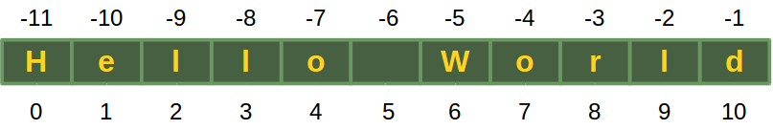
Extracting individual characters from a string
String consists of a series or sequence of characters (letters, numbers, special characters, space, tab, etc)
The characters in a string are numbered from 0 to length -1
>>> s = "Hello World" # length = 11 (from 0 to 10)
You can use square brackets to get the character at a given position
first = s[0] # this is “H”
This is called subscripting or indexing
The position must be smaller than the length
print(s[11]) # ERROR: string index out of range

Slide 22
String length
The length of a string is the number of characters in it.
Spaces count!
To get the length of a string, use the len function:
s = "Hello World"
numchars = len(s) # that’s 11 characters
Argument type: string
Return type: integer
What’s len(“”)?
0

Slide 23
Extracting characters with negative subscripts
You can subscript with negative numbers, counting from the right end
s[-1] is the last, rightmost character
s[-2] is the next to last character
…
s[-len(name)] is the first, left most character

Slide 24
Strings are Immutable
Python strings cannot be changed once created. That is strings are immutable
>>> s = "Some things are immutable!"
>>> s[1] = "."
Traceback (most recent call last):
File "<stdin>", line 1, in <module>
TypeError: 'str' object does not support item assignment
>>>

Slide 25
Basic String Operations
Concatenation "Hello" + "World" → "HelloWorld"
Repetition String can be repeated or repeatedly concatenated with the asterisk operator "*":
"*-*" * 3 → "*-**-**-*"
Slicing Substrings can be created with the slice or slicing notation: "Python"[2:4] will result in "th"
Size len("Python") will result in 6

Slide 26
Basic String Operations
We can’t perform any other mathematical operations on strings, even if the strings look like numbers
The following are illegal:
'2‘ - '1‘
'eggs'/'easy'
'third‘ * 'a charm‘

Slide 27
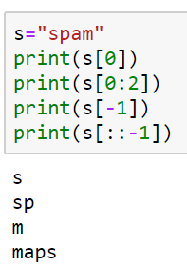
List and string
A string is a sequence of characters and a list is a sequence of values, but a list of characters is not the same as a string. To convert from a string to a list of characters, you can use list:
>>> s = 'spam'
>>> t = list(s)
>>> t
['s', 'p', 'a', 'm']

Slide 28
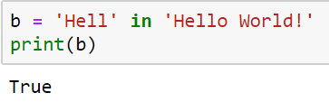
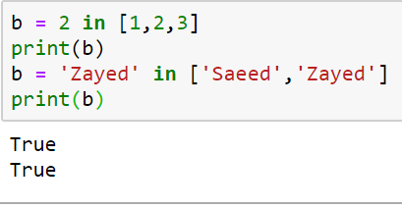
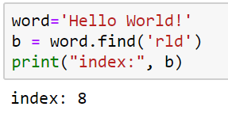
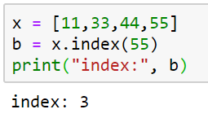
Strings versus lists
You’ve probably noticed a lot of similarities between lists and strings
Sometimes the very same code works with both!
len, subscripts, slicing
Traversal
Concatenation
But there are also many differences
Each element in a string is a character (a string of length 1)
But the elements of a list can be anything
Strings, numbers, bools, even other lists!
With strings, in searches for a substring
With lists, in searches for whole elements only!
Strings use find to locate a substring (-1 if not found)
Lists use index to locate an error (error if not found)
Another big difference: lists are mutable

Slide 29
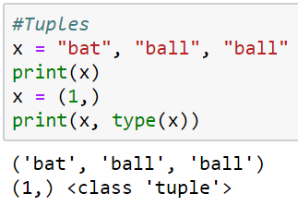
Tuples
Tuples are a collection of data items. They may be of different types. Tuples are immutable (like strings).
Same as lists but Immutable
Python optionally uses brackets () to denote tuples
We could have also used () for the above tuple
If we have only one item, we need to use a comma to indicate it's a tuple: e.g. (“Bat”,)

Slide 30
Immutable Types
Strings and Tuples are immutable, which means that once you create them, you can not change them.
The assignment operator (=) can make a variable point to strings or tuples just like simple data types:
myString = “This is a test”
myTuple = (1,45.8, True, “String Cheese”)‏
Strings & Tuples are both sequences, which mean that they consist of an ordered set of elements, with each element identified by an index.

Slide 31
Working with Tuples
Most list operators also work on tuples. The bracket operator indexes an element
>>> t = ("tuples", "are", "immutable")
>>> t[0]
'tuples'
>>> t[0]="assignment not possible"
Traceback (most recent call last):
File "<stdin>", line 1, in <module>
TypeError: 'tuple' object does not support item assignment
Immutable Type

Slide 32
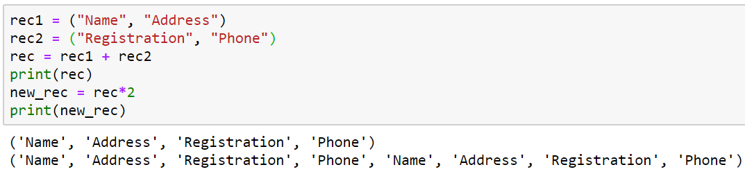
Working with Tuples
The slice operator selects a range of elements:
>>> t = ('a', 'b', 'c', 'd', 'e')
>>> t[1:3]
('b', 'c')
Try
Range: [start:stop:step]
+ and *

Slide 33
Sorting tuples
>>> atuple = (33, 22, 11)
>>> atuple.sort() Traceback (most recent call last): … AttributeError: 'tuple' object has no attribute 'sort'
>>> atuple = sorted(atuple)
>>> atuple [11, 22, 33]
Tuples are immutable!
sorted( ) returns a list!

Slide 34
Most other things work!
>>> atuple = (11, 22, 33)
>>> len(atuple) 3
>>> 44 in atuple False
Converting sequences into tuples
>>> alist = [11, 22, 33]
>>> atuple = tuple(alist)
>>> atuple (11, 22, 33)
>>> newtuple = tuple('Hello World!')
>>> newtuple ('H', 'e', 'l', 'l', 'o', ' ', 'W', 'o', 'r', 'l', 'd', '!')

Slide 35
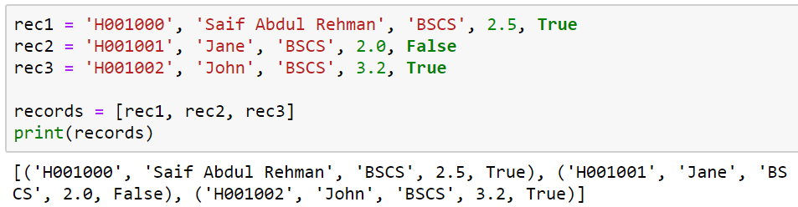
List of Tuples
Tuple is a record
So a list of records could be constructed

Slide 36
Dictionaries
A dictionary is like a list, but more general.
In a list, the indices have to be integers; in a dictionary they can be (almost) any type.
Keys must be unique within a dictionary: No duplicates
Simply put, a dictionary is a list of key-value pairs.
empty_dict = {} # Empty dict Pythonic style
empty_dict2 = dict() # Empty dict less Pythonic
grades = { "Erik" : 80, "Tim" : 95 } # dictionary literal
Keys: “Erik”, “Tim”
Values: 80, 95
Key and values are separated by a colon
Paris of entries are separated by commas
Dictionary is enclosed within curly braces

Slide 37
Usage
If we have grades = { "Erik" : 80, "Tim" : 95 }
Look up the value for a key using square brackets
grades["Erik"] is 80 grades[“Tim"] is 95
KeyError if you ask for a key that’s not in the dictionary
kates_grade = grades["Kate"]

Slide 38
Check for the existence of a key using in:
erik_has_grade = "Erik" in grades # True
kate_has_grade = "Kate" in grades # False
Using get method to return a value:
eriks_grade = grades.get("Erik", 0) # equals 80
kates_grade = grades.get("Kate", 0) # equals 0
no_ones_grade = grades.get("No One") # default is None
You assign key-value pairs using the same square brackets:
grades["Tim"] = 99 # replaces the old value
grades["Kate"] = 100 # adds a third entry
num_students = len(grades) # equals 3

Slide 39
Displaying contents
>>> age = {'Alice' : 25, 'Carol': 'twenty-two'}
>>> age.items() dict_items([ ('Alice', 25), ('Carol', 'twenty-two')])
>>> age.keys() dict_keys([ 'Alice', 'Carol'])
>>> age.values() dict_values([25, 'twenty-two'])

Slide 40
Updating directories
>>> age = {'Alice': 26 , 'Carol' : 22}
>>> age.update({'Bob' : 29})
>>> age {'Bob': 29, 'Carol': 22, 'Alice': 26}
>>> age.update({'Carol' : 23})
>>> age {'Bob': 29, 'Carol': 23, 'Alice': 26}

Slide 41
Dictionaries are mutable
>>> age = {'Alice' : 25, 'Bob' : 28}
>>> saved = age
>>> age['Bob'] = 29
>>> age {'Bob': 29, 'Alice': 25}
>>> saved {'Bob': 29, 'Alice': 25}

Slide 42
Dictionaries - a simple way to represent structured data:
tweet = {
"user" : “mhumayoun",
"text" : “Python is Awesome",
"retweet_count" : 100,
"hashtags" : ["#data", "#science", "#datascience"]
}
Besides looking for specific keys we can look at all of them:
tweet_keys = tweet.keys() # list of keys
tweet_values = tweet.values() # list of values
tweet_items = tweet.items() # list of (key, value) tuples
"user" in tweet_keys # True, but uses a slow list in
"user" in tweet # more Pythonic, uses faster dict in
“mhumayoun" in tweet_values # True

Slide 43
Summary of Containers or Compound Data Types
A data type in which the values are made up of elements that are themselves values
Strings – Enclosed in Quotes, holds characters, (immutable): “This is a String”
Lists – Enclosed in square brackets, separated by commas, holds any data type (mutable): [4, True, “Test”, 34.8]
Dictionaries – Enclosed in curly brackets, elements separated by commas, key : value pairs separated by colons, keys can be any immutable data type, values can be any data type (mutable): { 1 : “I”, 2 : ”II”, 3 : “III”, 4 : “IV”, 5 : “V” }
Tuples – Values separated by commas, (usually enclosed by parenthesis) and can hold any data type (immutable): (4 , True, “Test”, 34.8)‏

